Slide 1
Final presentation
By: Mack Arnold

Slide 2
Commuter Releif
This application will store your cars
It will store your reports you make with the correct calculations
Soon it will be able to email it to your employer
You can delete cars and reports to your liking
Only the Admin(me) can delete users.

Slide 3
My individual research topic
I implemented a code quality plugin to ensure that my code isn’t as bad as it was
The next couple slides will show that there weren’t that many errors.
Just some unused objects I created, and some names that it didn’t understand that I will explain when I get to it.

Slide 4
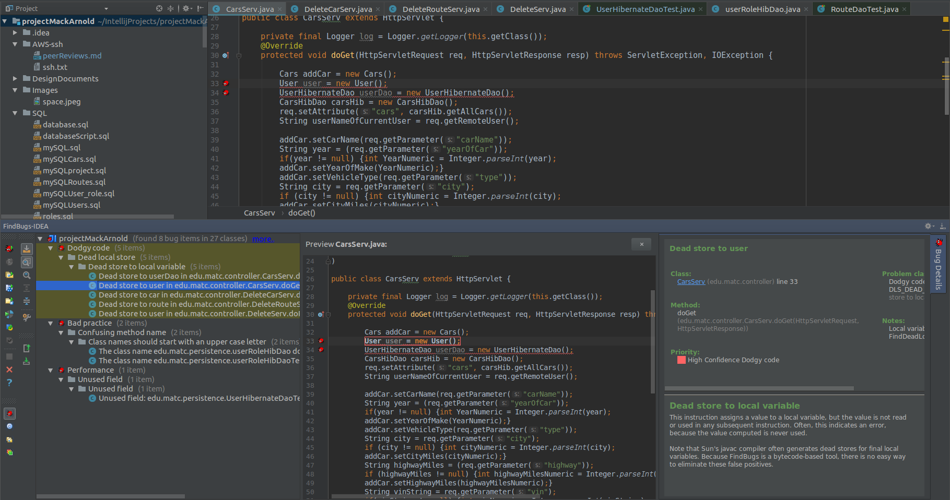
This is an example of the plugin finding an object I made and never used, which intellij sees as well, but this helped me delete redundant code.

Slide 5
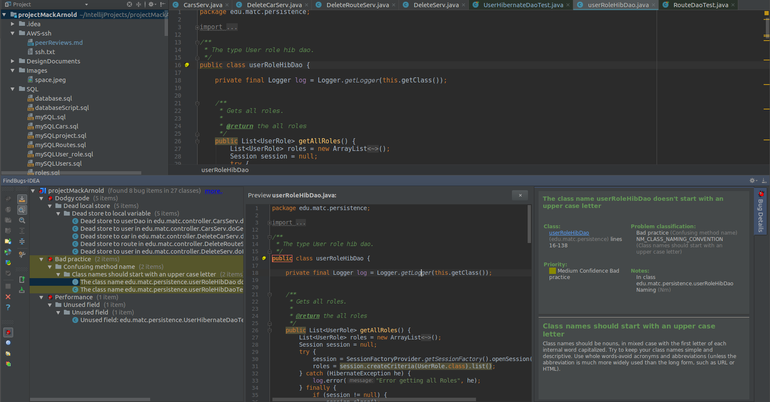
This is to show you that when you run the bug finder, it will say how many bugs in how many classes it analyzed.

Slide 6
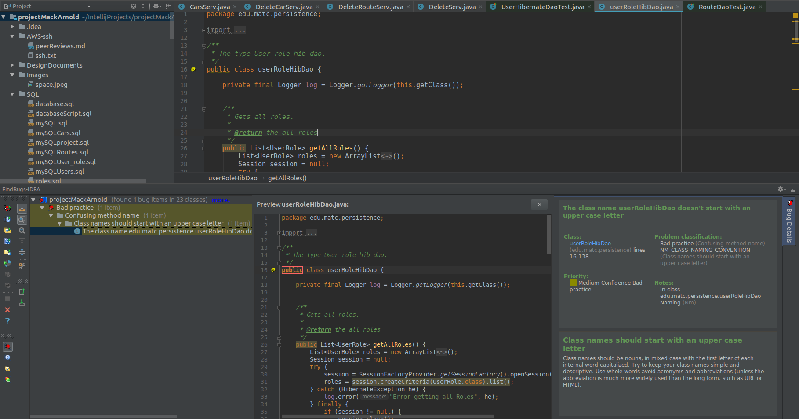
And this is What I found that Paula pointed out to me that not everything it will tell you needs to be changed. For this example its complaining about my real weird name for my classes and in this case I don’t have to change anything, its just the way I code and read it. It also complains when it sees that I don’t have an uppercase class name which can be easily overlooked.

Slide 7
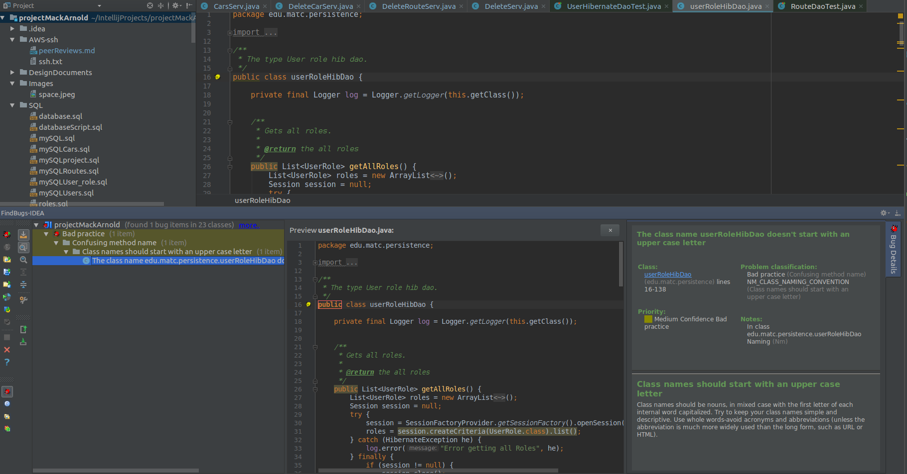
This is another example from the last slide where the class didn’t start with a capital letter, but when you hover over the name it says couldn’t comprehend the name, but I couldn’t hover and screenshot at the same time.

Slide 8
This is the end of my final Individual presentation for Enterprise Java.

